Slide 1
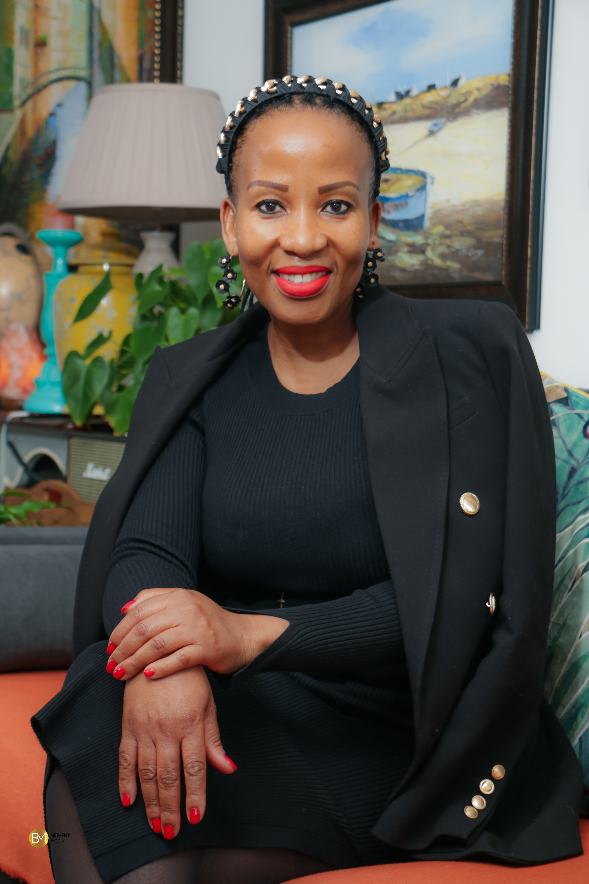
J Joy Machoene Kaapu
Joy brings over 20 years of corporate and consulting experience from her work as a Leadership Development and Organisational Culture Transformation Consultant. She has been trained as a Facilitator of Transformation by McKinsey & Company and Gita Bellin & Associates in Provence, the South of France. Joy is certified as a Leadership Coach from The Co-Active Training Institute in Spain and StrengthsFinder Coach from Gallup. Her academic background is in Human Resources Management, and she is also a certified Culture Transformation Consultant from the Barrett Values Centre. She applies a holistic approach to business performance by taking organisations on a journey to awaken the innate human potential in their teams which helps them to embed a thriving culture that drives sustainable success. Her approach to work is centered around Mindsets, Behaviours and Capabilities while co-creating with clients to shift root perspectives that brings about personal and organisational culture transformation.
Joy is South African by birth and currently resides in Johannesburg. She consults globally and loves co-creating with clients beyond borders. My clients describe me as a catalyst for leadership development and organisational culture transformation. They resonate with the psychological safety I create while taking them out of their comfort zones to shift mindsets, behaviours, capabilities and transform cultures.
Expertise
Culture Transformation
Personal Mastery
Top Team Development for High Performance
Executive Coaching
Leadership Development
Transformational Coaching
Gallup Clifton StrengthFinder Coaching
Mindsets, Behaviours and Capabilities Facilitator
Sector experience
Mining & Energy
Telecommunications
Insurance
Logistics
Government
Agriculture
Education
Capabilities & Instruments
Trainer of Facilitators & Team Coaches - Gita Bellin & Associates
Co-Active Coach – Co-Active Training Institute
Cultural Transformation Tools (CTT) Level 1 & 2 - Barrett Values Centre
Gallup Clifton StrengthFinder Coach

